Slide 1
Consumer Decision Making
Paula Parpart
March 20th, 2017
Applied Decision Making

Slide 2
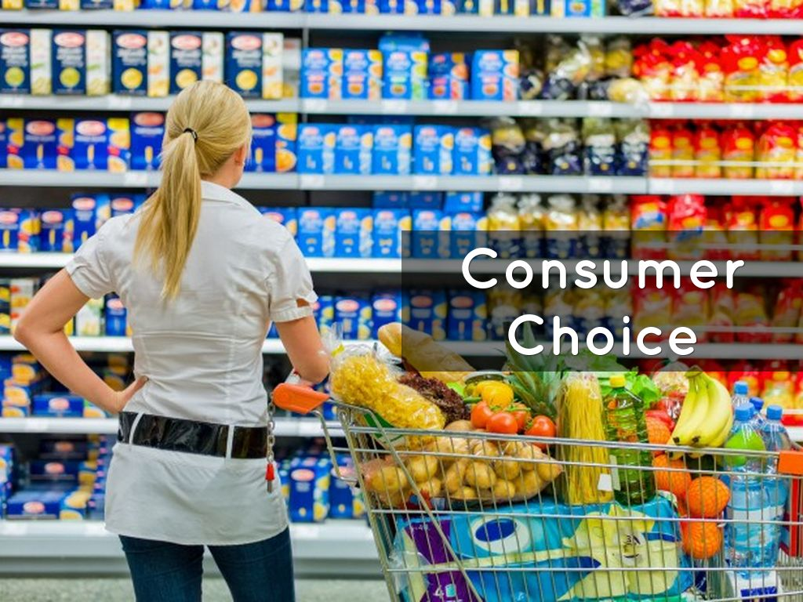
Consumer Decision Making
Everyday we are faced with a plethora of consumer choices (and options)
Small and routine
What to buy for lunch?
Food shopping
Books, Clothes, …
Larger and less frequent
Buying Computer, Phone
Buying car, house, …
Buying insurance, mortgage, shares, education…

Slide 3
Outline
Part I: Are consumer preferences constructed?
Explore/Exploit in Consumer Decision Making
Choice Blindness
Part II
Theoretical Part: Models of Consumer DM
Rational Choice Theory
Bounded Rationality
Constructive Choice Processes
Decision Strategies with different Goals
Example: Reason-based strategies
Choice Overload

Slide 4
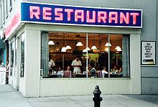
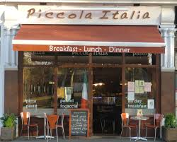
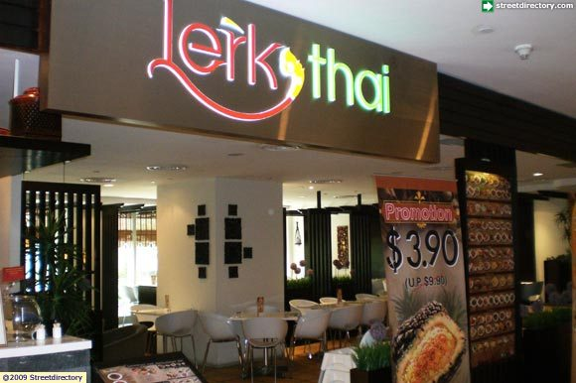
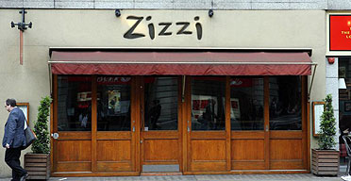
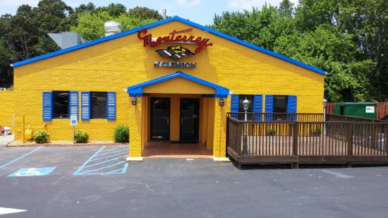
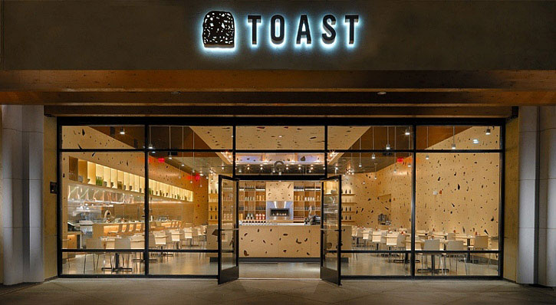
Explore/Exploit in Consumer DM
Exploiting preferred options versus exploring to gather information^{1,2}
Costs:
– Exploitation: missing out on changes
– Exploration: choosing inferiorly
[1] Trade-off between explore and exploit (Cohen et al., 2007)
[2] Hills et al. (2015)
Notes:
Effective decision-making requires balancing exploratory and exploitative behaviour
For example, finding a restaurant that is better than one’s current favourite requires some exploration.

Slide 5
Explore/Exploit in Consumer DM
Normatively, the rate of exploration should increase as the uncertainty about the relative goodness of options increases.¹
People in laboratory studies with objective rewards (e.g., money) behave in a manner consistent with the ideal actor, exploring more often when uncertainty is high.^{2,3,4}
[1] Knox et al. (2012), Front. Psychol.
[2] Blanco et al. (2013), Cognition
[3] Otto et al. (2014), Cogn. Affect. Behav. Neurosci.
[4] Blanco et al. (2015), Neuobiol. Learn. Mem.
Notes:
For example, one may give a restaurant a second chance after a year has passed because the service could have improved in the interim.

Slide 6
But what about subjective rewards? (Riefer, Prior, Blair, Pavey, & Love, 2017)
However, as in the restaurant example, rewards can be subjective rather than objective.
It may be clear that higher monetary rewards are better, but comparing the reward of two dining experiences is subjective and multidimensional (atmosphere, service, food…)
Determining value becomes interpretive exercise.
This interpretative process can be self-reinforcing, such that people come to prefer what they happen to choose.
→ Do people alter their preferences to be coherent with their previous behaviour?

Slide 7
Patterns of exploration
[3-5]
[6-8]
[3] Knox et al. (2012), Front. Psychol. [4] Blanco et al. (2013), Cognition [5] Otto et al. (2014), Cogn. Affect. Behav. Neurosci.
[6] Johansson et al. (2014), J. Behav. Decis. Making [7] Festinger (1957) [8] Sharot, Velasquez & Dolan (2010), Psychol. Sci.
Notes:
With objective rewards, the likelihood of exploring increases the longer it has been since exploring
If people alter their preferences to match their choices, then patterns of exploration should be opposite to that found with objective monetary rewards.
If instead preferences conform to choices, then people should become less likely to explore the more they exploit.

Slide 8
Coherency maximization Hypothesis
The longer people repetitively exploit an option, the more entrenched their preferences becomes.
Such increased liking for chosen options strengthens coherence between preference and past behaviour, which then promotes coherent future behaviour based on this preference.
H: People’s probability of exploring should go down with longer exploitation streaks.
exploitation streak
Notes:
With objective rewards, the likelihood of exploring increases the longer it has been since exploring
If people alter their preferences to match their choices, then patterns of exploration should be opposite to that found with objective monetary rewards.
If instead preferences conform to choices, then people should become less likely to explore the more they exploit.

Slide 10
Results

Slide 11
Results
Consistent with the coherency-maximizing view, shoppers were overall less likely to explore on their next purchase when currently on a long run of exploitative choices.
Notes:
A median split of exploitation streaks by shopper revealed that, in line with the predictions for coherency maximization, people were overall less likely to explore on their next purchase when currently on a long run of exploitative choices.

Slide 12
Logistic Regression Model
Modelling people’s choices: Predicting probability of exploring (DV) with exploitation streak length (IV).
Impact was negative (slope) for 79.3% of shopper datasets.
→ people are coherency maximizers.
Negative slopes!

Slide 13
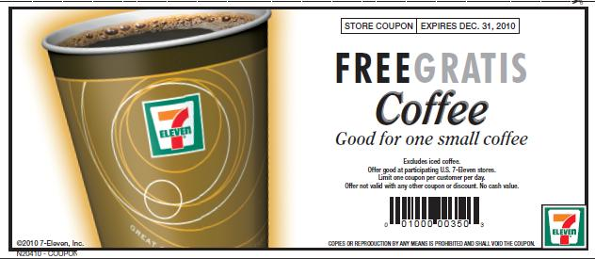
Do preferences arise from choices?
Coupon redemption study to test predictions
Authors issued coupons for instant coffee to 8,623 randomly selected households who regularly buy instant coffee
Logistic regression was fit to predict coupon redemption probability based on exploitation streak length
Notes:
A shopper was more likely to redeem a coupon to exploit, the longer the exploitation streak,
whereas a coupon to explore was more likely to be redeemed the more recently a shopper had explored.

Slide 14
Do preferences arise from choices?
→ People’s choices induced preference changes, as their interest in coupon rewards depended on how well the coupon matched their recent choices (that is, their exploitation streak length).
Notes:
A shopper was more likely to redeem a coupon to exploit the longer the exploitation streak,
whereas a coupon to explore was more likely to be redeemed the more recently a shopper had explored.

Slide 15
Interim Summary
Strong evidence that shoppers are coherency-maximizing which is striking as it is opposite of what normative theories predict and what previous research finds with objective rewards (money), i.e., uncertainty minimizing exploration.
Preferences may follow choices. Is that irrational?
What could be possible explanations for this seemingly irrational beh.?
Normative theories:
Preferences
?
Choices
Evidence suggests:
Choices
Preferences
?

Slide 16
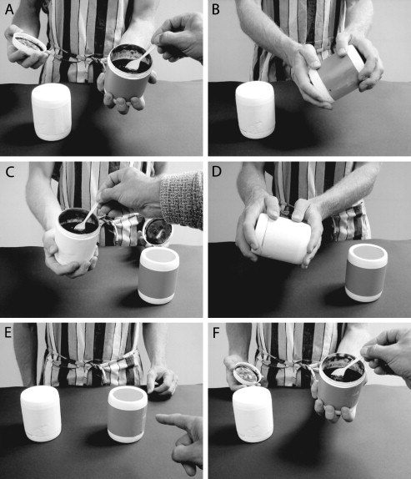
Choice Blindness
People justify their behaviours to be consistent with their choices (Hall et al., 2010)
Only a 1/3 of the manipulated trials were detected.
Considerable levels of choice blindness for the taste and smell of two different consumer goods.
Notes:
We set up a tasting venue at a local supermarket and invited passerby shoppers to sample two different varieties of jam and tea, and to decide which alternative in each pair they preferred the most
Immediately after the participants had made their choice, we asked them to again sample the chosen alternative, and to verbally explain why they chose the way they did.
At this point we secretly switched the contents of the sample containers, so that the outcome of the choice became the opposite of what the participants intended.

Slide 17
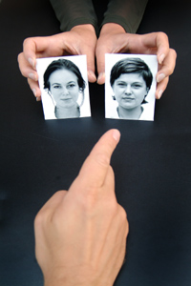
Choice Blindness: Which face do you find more attractive?
People justify their behaviours to be consistent with their choices (Johansson et al., 2005, Science)
This phenomenon could be reproduced with multiple different choice objects.
Notes:
Peter Johansson investigated subjects' insight into their own preferences using a new technique.
Subjects saw two photographs of people and were asked which they found more attractive. They were given a closer look at their "chosen" photograph and asked to verbally explain their choice.
However, in some trials, the experimenter had slipped them the other photograph rather than the one they had chosen, using sleight of hand.^{[13]}
A majority of subjects failed to notice that the picture they were looking at did not match the one they had chosen just seconds before

Slide 18
Notes:
Peter Johansson investigated subjects' insight into their own preferences using a new technique.
Subjects saw two photographs of people and were asked which they found more attractive. They were given a closer look at their "chosen" photograph and asked to verbally explain their choice.
However, in some trials, the experimenter had slipped them the other photograph rather than the one they had chosen, using sleight of hand.^{[13]}
A majority of subjects failed to notice that the picture they were looking at did not match the one they had chosen just seconds before

Slide 19
Interim Discussion
Does this suggest we don’t have any stable preferences at all?
The radical hypothesis of this idea is called the “Mind-is-flat” Hypothesis (Prof. Nick Chater, Warwick Business School)
http://www2.warwick.ac.uk/newsandevents/knowledge/socialscience/themindisflat (interesting lecture to watch)

Slide 20
This first half poses the question: Is consumer choice a constructive phenomenon?

Slide 21
Theoretical Part II: Models of consumer decision making

Slide 22

Choice frameworks
Rational choice theory
Standard economic view
Bounded rationality
Constructive choice
Heuristics
Reason-based

Slide 23
Rational choice theory
Rational DM with well-defined preferences
Preferences do not depend on way options are described or elicitation methods
Preferences can be represented as real-valued utility functions
Economic decision making then becomes a problem of maximizing this utility function
Preferences follows axioms of Completeness and Transitivity.
Each option in choice set has a subjective value that depends only on that option (context-independence)

Slide 24
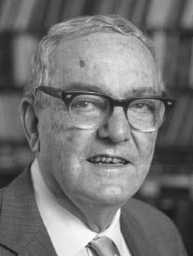
Bounded rationality
Boundedly rational agents experience limits in formulating and solving complex problems and in processing (receiving, storing, retrieving, transmitting) information (Simon, 1957, 1990)
Heuristics
Kahneman & Tversky emphasize short-cut nature of heuristics and the systematic biases they lead to when used inappropriately
Gigerenzer et al emphasize adaptive fit between heuristics and environment (and argue that they often provide better solutions than ‘optimal’ procedures)

Slide 25
Constructive choice processes (Bettman, Luce & Payne, 1998)
DMs often do not have well-defined preferences
Preferences for options are constructed rather than retrieved
Problem representations often developed on the spot by structuring of available information
Preferences thus highly context-dependent
And decision processes highly sensitive to local problem structure

Slide 26
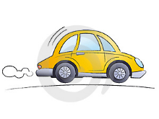




Example of consumer task
CAR | Reliability | Price | Safety | Horsepower
A | Worst | Best | Good | Very poor
B | Best | Worst | Worst | Good
C | Poor | Very Good | Average | Average
D | Average | Poor | Best | Worst
E | Worst | Very Poor | Good | Best
Set of alternatives and their values on list of attributes

Slide 27





General Decision Strategies
Amount of info processed
Full vs restricted
Selectivity
Consistent: same amount processed for each attribute
Selective: Different amounts for each alternative or attribute
Eg look at safety only
CAR | Reliability | Price | Safety | Horsepower
A | Worst | Best | Good | Very poor
B | Best | Worst | Worst | Good
C | Poor | Very Good | Average | Average
D | Average | Poor | Best | Worst
E | Worst | Very Poor | Good | Best
Pattern of processing
By alternative: consider multiple attributes of one option at a time
By attribute: consider one attribute at a time for multiple options
Compensatory vs. non-compensatory
Comp: good value on one attribute can compensate for bad value on another; hence explicit trade-offs

Slide 28
Weighted additive model
w₁ w₂ w₃ w₄
Assume DM can assess importance weight of each attribute (w_{i})
Consider one option at a time
CAR | Reliability | Price | Safety | Horsepower
A | Worst | Best | Good | Very poor
B | Best | Worst | Worst | Good
C | Poor | Very Good | Average | Average
D | Average | Poor | Best | Worst
E | Worst | Very Poor | Good | Best

Slide 29





Weighted additive model
w₁ w₂ w₃ w₄
CAR | Reliability | Price | Safety | Horsepower
A | Worst | Best | Good | Very poor
B | Best | Worst | Worst | Good
C | Poor | Very Good | Average | Average
D | Average | Poor | Best | Worst
E | Worst | Very Poor | Good | Best

Slide 30
Weighted additive model
.1 .4 .3 .2
CAR | Reliability | Price | Safety | Horsepower
A | Worst | Best | Good | Very poor
B | Best | Worst | Worst | Good
C | Poor | Very Good | Average | Average
D | Average | Poor | Best | Worst
E | Worst | Very Poor | Good | Best

Slide 31
Weighted additive model
.1 .4 .3 .2
CAR | Reliability | Price | Safety | Horsepower
A | Worst (0) | Best (6) | Good (4) | Very poor (1)
B | Best (6) | Worst (0) | Worst (0) | Good (4)
C | Poor (1) | Very Good (5) | Average (3) | Average (3)
D | Average (3) | Poor (2) | Best (6) | Worst (0)
E | Worst (0) | Very Poor (1) | Good (4) | Best (6)
3.8
1.4
3.6
2.9
2.8
e.g., A: (.1x0)+(.4x6)+(.3x4)+(.2x1) = 3.8

Slide 32
Weighted additive model
w₁ w₂ w₃ w₄
Assume DM can assess importance weight of each attribute (w_{i})
Consider one option at a time
Examine all attributes and compute weighted sum (value x importance weight)
Choose option with highest weighted value
CAR | Reliability | Price | Safety | Horsepower
A | Worst | Best | Good | Very poor
B | Best | Worst | Worst | Good
C | Poor | Very Good | Average | Average
D | Average | Poor | Best | Worst
E | Worst | Very Poor | Good | Best
Compensatory strategy that involves explicit trade-offs
Considered more accurate but more demanding on DM’s working memory and computational capabilities

Slide 33
Equal weight or “Tallying”
w₁ w₂ w₃ w₄
Simplified version of weighted additive (Dawes, 1979)
Considers all alternatives and all attributes but ignores information about attribute weights
Value computed for each alternative by summing attribute values
Select option with highest sum
CAR | Reliability | Price | Safety | Horsepower
A | Worst | Best | Good | Very poor
B | Best | Worst | Worst | Good
C | Poor | Very Good | Average | Average
D | Average | Poor | Best | Worst
E | Worst | Very Poor | Good | Best

Slide 34
Equal weight
CAR | Reliability | Price | Safety | Horsepower
A | Worst (0) | Best (6) | Good (4) | Very poor (1)
B | Best (6) | Worst (0) | Worst (0) | Good (4)
C | Poor (1) | Very Good (5) | Average (3) | Average (3)
D | Average (3) | Poor (2) | Best (6) | Worst (0)
E | Worst (0) | Very Poor (1) | Good (4) | Best (6)
11
10
12
11
11
e.g., A: 0 + 6 + 4 + 1

Slide 35
Equal weight
w₁ w₂ w₃ w₄
Simplified version of weighted additive (Dawes, 1979)
Considers all alternatives and all attributes but ignores information about attribute weights
Unit-weights all attributes
(importance weights of 1)
CAR | Reliability | Price | Safety | Horsepower
A | Worst | Best | Good | Very poor
B | Best | Worst | Worst | Good
C | Poor | Very Good | Average | Average
D | Average | Poor | Best | Worst
E | Worst | Very Poor | Good | Best
Processing is extensive, consistent, and compensatory.

Slide 36
Lexicographic model and “Take-The-Best “ Heuristic
w₁ w₂ w₃ w₄
Select the alternative with best value on the most important attribute
Eg if price most important then select car A
CAR | Reliability | Price | Safety | Horsepower
A | Worst | Best | Good | Very poor
B | Best | Worst | Worst | Good
C | Poor | Very Good | Average | Average
D | Average | Poor | Best | Worst
E | Worst | Very Poor | Good | Best
Limited, attribute-based and non-compensatory processing that is selective across attributes and consistent across alternatives
Notes:
Like TTB heuristic

Slide 37
Satisficing
Classic strategy from Simon (1955)
Alternatives considered sequentially in the order that they occur in choice set
Value for each attribute compared against a predetermined cutoff
Option rejected if it fails to meet cutoff
First option that passes cutoffs for all attributes is selected (or reduce cutoffs)
CAR | Reliability | Price | Safety | Horsepower
A | Worst | Best | Good | Very poor
B | Best | Worst | Worst | Good
C | Poor | Very Good | Average | Average
D | Average | Poor | Best | Worst
E | Worst | Very Poor | Good | Best
e.g., cutoff ‘not worst’
Order-dependent, alternative-based, selective and non-compensatory
Extent of processing varies according to cutoff values and attribute levels

Slide 38
Decision Strategies
STRATEGY | Amount of info processed | Selective vs. Consistent | Attribute-based vs. Alternative-based
Weighted adding | Extensive | Consistent | Alternative
Lexicographic | Limited | Selective | Attribute
Satisficing | Variable | Selective | Alternative
Equal weight | Extensive | Consistent | Alternative
Elimination-by-aspects | Variable | Selective | Attribute
…and various other strategies (see Bettman, Luce & Payne, 1998)
Meta-decision to select strategy? e.g. Adaptive Toolbox Approach (Scheibehenne et al., 2013, Todd, Gigerenzer & ABC, 1999)

Slide 39
Key consumer DM research findings
Very important, see Bettmann, Luce & Pane, 1998
Choice among decision strategies depends on:
Goals of DM
E.g.: minimizing cognitive effort; maximizing accuracy; minimizing negative emotions; maximizing ease of justification… or some combination of these
Complexity of decision task
Simple decision processes increase with more complex tasks
Methods of preference elicitation
Framing of choice set
Eg whether outcomes represented as gains or losses
Notes:
One of the most important findings from prior consumer research is that the same individual may use a variety of different strategies when making decisions.

Slide 40
Key consumer DM research findings
One of the most important findings from prior consumer research is that the same individual may use a variety of different strategies when making decisions (Bettman, Luce & Payne, 1998)
Notes:
One of the most important findings from prior consumer research is that the same individual may use a variety of different strategies when making decisions.

Slide 41
Goal: Maximising Ease of Justification
Next few slides give examples of reason-based strategies

Slide 42
Choice under conflict: adding options
Standard decision theory states that preference orderings between options should not be changed by introduction of additional options
“We have chocolate ice cream available for dessert.”
“Oh…no thank you.”
“Actually, we also have coconut ice cream.”
“Oh…OK. I’ll have the chocolate ice cream please.”
Reason-based choice explanation:
Adding coconut ice cream (yuck!) provides a reason for choosing the chocolate ice cream

Slide 43
Dominance
Suppose you are considering buying a stereo and have not yet decided what model to buy. You pass by a store that is having a one-day clearance sale.
They offer a popular SONY stereo for just $99, well below the list price. Do you
Buy the SONY stereo? 66%
Wait until you learn more about the various models. 34%
B. They offer a popular SONY stereo for just $99, well below list price, and an inferior AIWA stereo for the regular list price of $105. Do you?
Buy the AIWA stereo? 3%
Buy the SONY stereo? 73%
Wait until you learn more about the various models. 24%
Notes:
Hard to justify choice between AIWA and SONY in (A), so rather wait. No problem in B.

Slide 44
Dominance
Suppose you are considering buying a stereo and have not yet decided what model to buy. You pass by a store that is having a one-day clearance sale.
They offer a popular SONY stereo for just $99, well below list price, and an inferior AIWA stereo for the regular list price of $105. Do you?
Buy the AIWA stereo? 3%
Buy the SONY stereo? 73%
Wait until you learn more about the various models. 24%
SONY is chosen more often than before the addition of the inferior AIWA
AIWA is clearly dominated by SONY
Its presence enhances the reasons for buying SONY
Notes:
Hard to justify choice between AIWA and SONY in (A), so rather wait. No problem in B.

Slide 45



Asymmetric dominance
Tendency to prefer X to Y can be increased by adding an alternative Z that is clearly inferior to X but not to Y
Simonson & Tversky (1992)
One group of subjects offered choice between $6 and elegant ‘Cross’ pen
Cross Pen selected by 34%
Another group offered choice between $6, the elegant ‘Cross’ pen and a second less attractive pen
Cross Pen selected by 46%
The presence of the bad pen provides an argument for choosing the Cross pen over the cash
Notes:
Also...Hsee ‘evaluability’

Slide 46
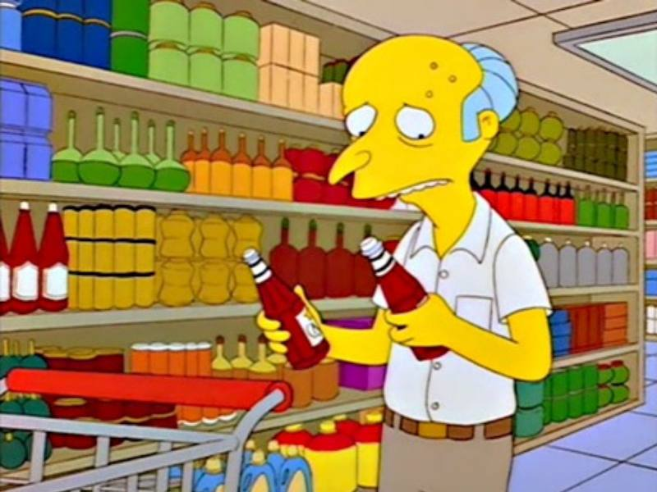
The paradox of “Too much choice”
Consumers often have plethora of choices
Large supermarkets
Online shopping…
Common assumption was that variety of choice is a good thing
But a line of research question this
Choice overload hypothesis (Iyengar & Lepper, 2000)
Provision of extensive choices might be initially desirable
But can be demotivating

Slide 47
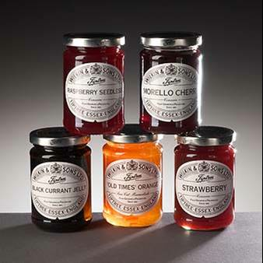
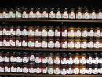
Jams experiment
Field study in large US supermarket (Iyengar & Lepper, 2000)
Stalls with variety of different jams
Limited (6) vs. Extensive (24) selections
40% customers stopped to taste
30% of these bought some
60% customers stopped to taste
3% of these bought some

Slide 48
Choice overload
Effect replicated with chocolates
Explanation (Iyengar & Lepper, 2000)
‘Choosers in extensive-choice contexts enjoy the choice process more, but also feel more responsible for the choices they make, resulting in frustration with the choice-making process and dissatisfaction with their choices’
Subsequent studies question the robustness of the effect (e.g., Scheibehenne et al., 2010)
Attention directed to moderators and antecedents (i.e., reasons/explanations) for the effect (e.g., Chernev et al., 2010)
Notes:
But...how much is too much choice?

Slide 49
Summary
PART I
Evidence suggests a lot of consumer choice is constructive.
Preferences determine choice, but it can go the other way as well: Choices can determine preferences (see study by Riefer et al., 2016)
PART II
There are a variety of goals for a consumer facing a choice
Different decision strategies meet different goals
Different situations trigger different goals
Hence different situations trigger different decision strategies
Awareness of this likely beneficial to sales executives

Slide 50
References
Riefer, P. S., Prior, R., Blair, N., Pavey, G., & Love, B. C. (2017). Coherency-maximizing exploration in the supermarket. Nature Human Behaviour, 1, 0017.
Shafir, Simonson & Tversky (1993). Reason-based Choice. Cognition, 49, 11-36.
J.R. Bettman, M.F. Luce, and J.W. Payne. (1998). Constructive consumer choice processes. Journal of Consumer Research, 25:187-217.
Iyengar, S. & Lepper, M. (2000). When Choice is Demotivating: Can One Desire Too Much of a Good Thing? Journal of Personality and Social Psychology, 2000, Vol. 79, No. 6, 995-1006
Scheibehenne, B., Greifeneder, R., & Todd, P. M. (2010). Can there ever be too many options? A meta-analytic review of choice overload. Journal of Consumer Research, 37, 409-425.
Chernev, A., Bockenholt, U., & Goodman, J. (2010). Commentary on Scheibehenne and Todd. Choice overload: Is there anything to it? Journal of Consumer Research
Grifeneder, R., Scheibehenne, B., & Kleber, N. (2010). Less may be more when choosing is difficult: Choice complexity and too much choice. Acta Psychologica

Slide 51
Appendix: Additional examples for reason-based choice

Slide 52
Reason-based choice: Goal is maximizing ease of justification (Shafir, Simonson & Tversky, 1993)
Faced with a difficult choice people recruit reasons for and against each option
Conflict arises when DM has various reasons for and against, or conflicting reasons for competing options
Reason-based choice can explain framing and elicitation effects
(sensitivity of choice to ways in which options are described and methods of eliciting preferences)
Different frames (e.g., gains vs losses) and elicitation procedures (e.g., pricing vs choice) can bring forth different reasons

Slide 53
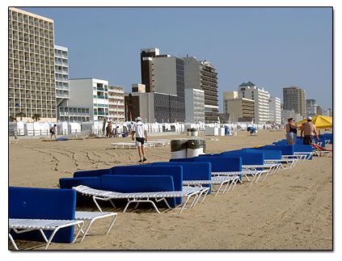

Imagine that you are planning a holiday in a warm spot over Easter. You currently have two options that are reasonably priced…
Spot A:
Average weather
Average beaches
Medium-quality hotel
Medium temperature water
Average nightlife
Spot A: Spot B:
Average weather Lots of sunshine
Average beaches Gorgeous beaches and coral reefs
Medium-quality hotel Ultra-Modern Hotel
Medium temperature water Very Cold Water, Very Strong Winds
Average nightlife No nightlife
…which do you prefer?
Notes:
Bad attributes are reasons for cancellation. Good
Prefer: Imagine that you are planning a week vacation in a warm spot

Slide 54
Imagine that you are planning a holiday in a warm spot over Easter. You currently have two options that are reasonably priced, but you can no longer retain your reservation in both…
Spot A:
Average weather
Average beaches
Medium-quality hotel
Medium temperature water
Average nightlife
Spot A: Spot B:
Average weather Lots of sunshine
Average beaches Gorgeous beaches and coral reefs
Medium-quality hotel Ultra-Modern Hotel
Medium temperature water Very Cold Water, Very Strong Winds
Average nightlife No nightlife
…which reservation do you decide to cancel?
Notes:
Bad attributes are reasons for cancellation. Good
Prefer: Imagine that you are planning a week vacation in a warm spot

Slide 55
Prefer versus cancel
Spot A: Spot B:
Average weather Lots of sunshine
Average beaches Gorgeous beaches and coral reefs
Medium-quality hotel Ultra-Modern Hotel
Medium temperature water Very Cold Water, Very Strong Winds
Average nightlife No nightlife
Prefer: 33% Prefer: 67%
Cancel: 52% Cancel: 48%
Notes:
Bad attributes are reasons for cancellation. Good
Prefer: Imagine that you are planning a week vacation in a warm spot

Slide 56
Reasons pro and con
Choosing between two options and
having to reject one of two options are equivalent under
standard analyses of choice
But according to reason-based choice:
When choosing people focus on positive reasons
When rejecting people focus on negative reasons
Result:
enriched option (with more pros & cons) vs impoverished option (with less pros and cons)
Enriched option chosen & rejected more than impoverished option (%C + %R > 100%)

Slide 57

Definite vs disjunctive reasons
Disjunctive version
Imagine you have taken a tough exam …You now have the opportunity to buy a 5-day vacation package to Hawaii at exceptionally low price. The special offer expires tomorrow, but your exam grade is not available until the following day. Would you:
Buy the vacation package
Not buy the vacation package
Pay a $5 non-refundable fee to reserve price until
the day after tomorrow – after you find out if you
passed the exam
32%
7%
61%

Slide 58
Definite vs disjunctive reasons
Pass/Fail versions
Imagine you have taken a tough exam …you find out that you passed [failed] the exam. You now have the opportunity to buy a 5-day vacation package to Hawaii at exceptionally low price. The special offer expires tomorrow. Would you:
Buy the vacation package
Not buy the vacation package
Pay a $5 non-refundable fee to reserve price until the day after tomorrow?
Pass
54%
16%
30%
Fail
57%
12%
31%

Slide 59
Definite vs disjunctive reasons
>50% chose vacation if they passed or if they failed, but only 32% if they did not know, and 61% willing to pay $5 to postpone decision until exam results known
Once exam result is known students have definite reasons for choice
If they pass, vacation is a reward
If they fail, vacation is a consolation
When they don’t know exam results, students lack a definite reason
Significant proportion of students willing to pay for information that would not affect their decision!

Slide 60
Additional Strategies: Elimination-by-Aspects
w₁ w₂ w₃ w₄
EBA combines lexicographic and satisficing (Tversky, 1972)
Eliminates options that do not meet a minimum cutoff on the most important attribute
Process repeated until a single option remains
Eg suppose DM’s most important attributes are price then horsepower, and cutoff is average value
First eliminate B,D & E (price)
Then eliminate A (horsepower)
Choose C
CAR | Reliability | Price | Safety | Horsepower
A | Worst | Best | Good | Very poor
B | Best | Worst | Worst | Good
C | Poor | Very Good | Average | Average
D | Average | Poor | Best | Worst
E | Worst | Very Poor | Good | Best
Attribute-based, non-compensatory and selectivity of processing depends on exact pattern of elimination

